Slide 1
Introduction to Programming in Python
Ezekiel Adebayo Ogundepo (@gbganalyst)

Slide 2
Basic Arithmetic Operations in Python

Slide 3
Python as a Calculator
Python can be used as a calculator to perform basic arithmetic operations.
Consider the following arithmetic operations:
Addition
Subtraction
Multiplication
Division
Exponentiation (or Powers)
Modulo

Slide 4
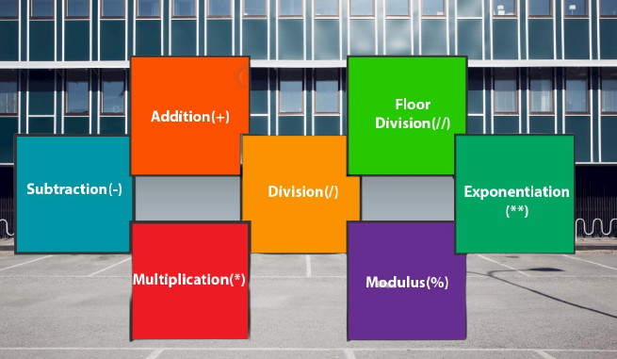
Python as a Calculator

Slide 5
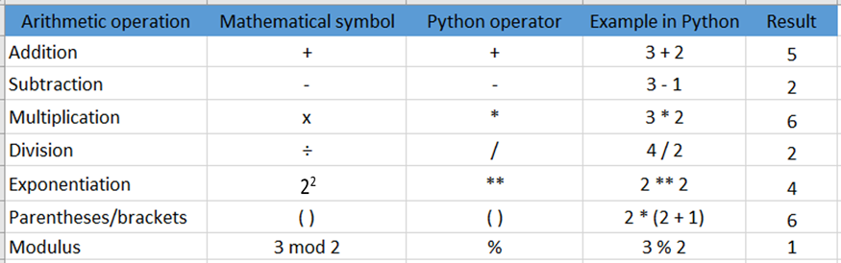
Python as a Calculator
+, -, *, /, **, and % are called arithmetic operators.

Slide 6

Lab session

